Slide 1
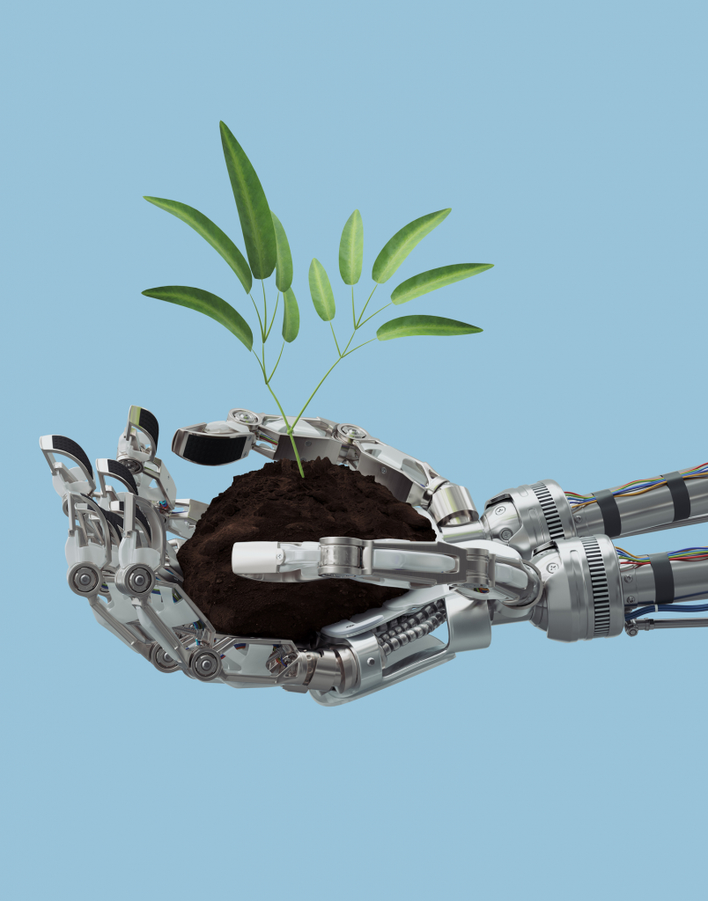

Impact of Technology in Agriculture
Eniola Ladipo
@eniola_ladipo

Slide 2
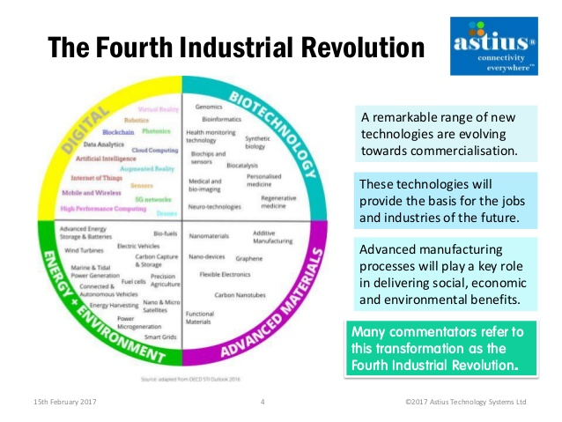
The Fourth Revolution of Data and Technology

Slide 3
Digital Technology
Efficiency
Profitability
Accountability

Slide 4
Statistics by Food and Agriculture Organisation (FAO)
Small farm holding produce 80% of food supply in Africa.
The world’s population would amount to over 9 billion by 2050.
We need a 70% increase in current food supply by 2050.

Slide 5
Targets to meet:
To overcome problems farmers are currently facing in the aspects of:
Data collection & analysis
Water sustainability
Pest and diseases control
Deforestation
Labour
Feeding over 9 billion people

Slide 6

What is the solution to our problems?

Slide 7
Different facets of Deep Tech:
Data Science (DS)
Machine Learning (ML)
Artificial Intelligence (AI)
Internet of Things (IoT)

Slide 8
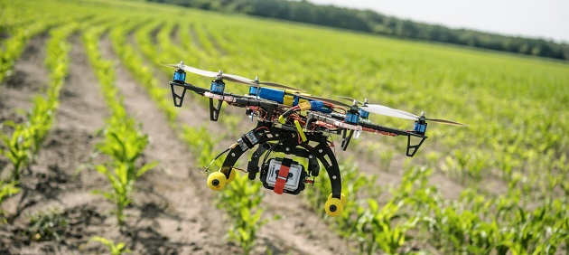

Slide 9
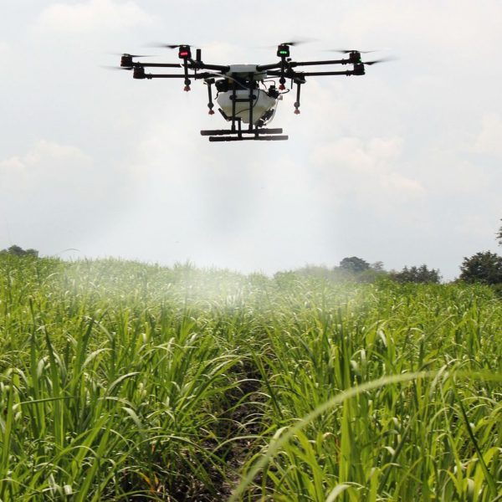

Slide 10
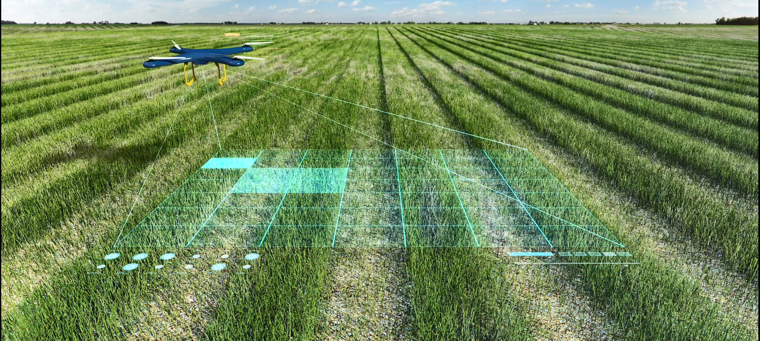

Slide 11
Deep Tech
IoT
AI
ML & DS

Slide 12

What is the essence of this talk?

Slide 13
Thank you.

